Slide 1
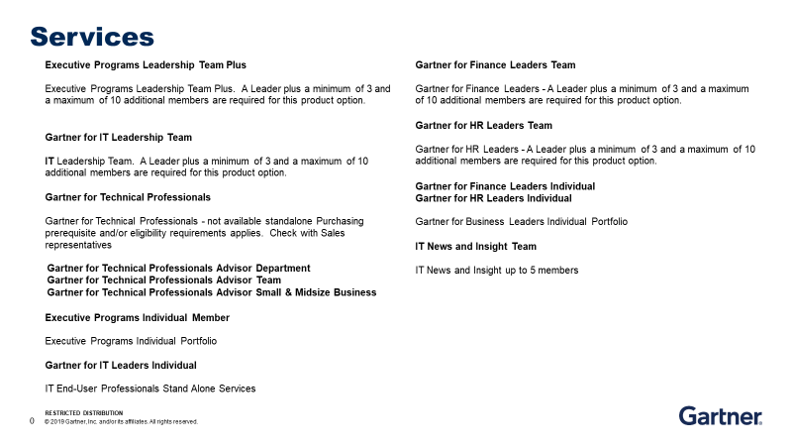
GARTNER - FA | GARTNER SERVICES
Valid until | 2025-12-31 | Suppliers | GARTNER | Engagement | Directly
Scope of Goods and Services

Slide 2
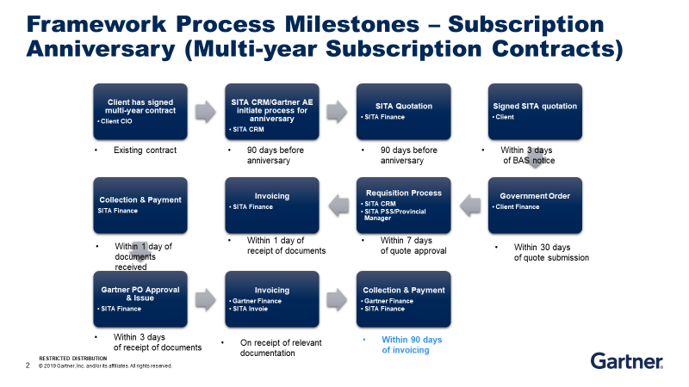
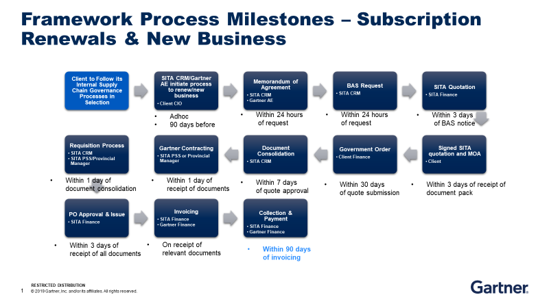
GARTNER - FA | GARTNER SERVICES
Valid until | 2025-12-31 | Suppliers | GARTNER | Engagement | Directly
Engagement Model
Engagement Model

